Slide 1
Foundations of Large Language Models: Tools, Techniques, and Applications
Notes:
Note for instructor: please ensure you check the accessibility of your own slides before you deliver your presentation: https://uwaterloo.ca/centre-for-teaching-excellence/accessibility-checklist-ms-powerpoint

Slide 2

Foundations of Large Language Models: Tools, Techniques, and Applications
(3rd edition)
Instructor: Brian Zimmerman
Photo source: Bing Image Creator

Slide 3
Overview of Today – Module 1
Module 1 Review
Self-Attention
Fine-tuning
Prompt Engineering

Slide 4
Lifecycle of LLMs
Two stage procedure:
Self-supervised pre-training (90% of cost)
Fine-tuning on a task

Slide 5
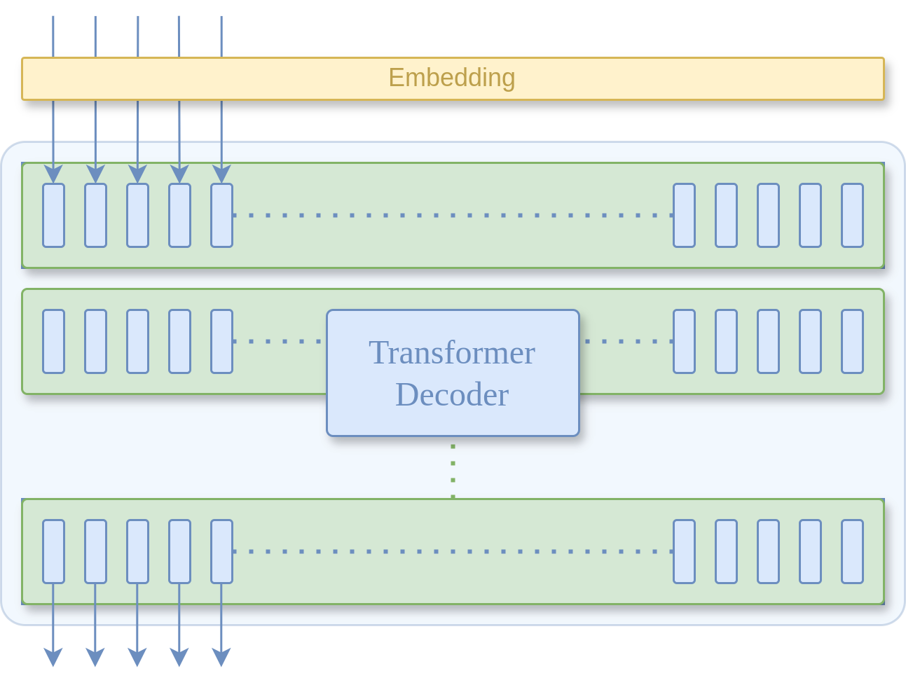
Self-supervised Pre-training
Input (Text)
The
the
dog
runs
around
Self-supervised datasets only require collected data, which the model learns to reconstruct.
Input | Source
Text | Business report, book, documentation, etc.
dog
the
runs
around

Slide 6
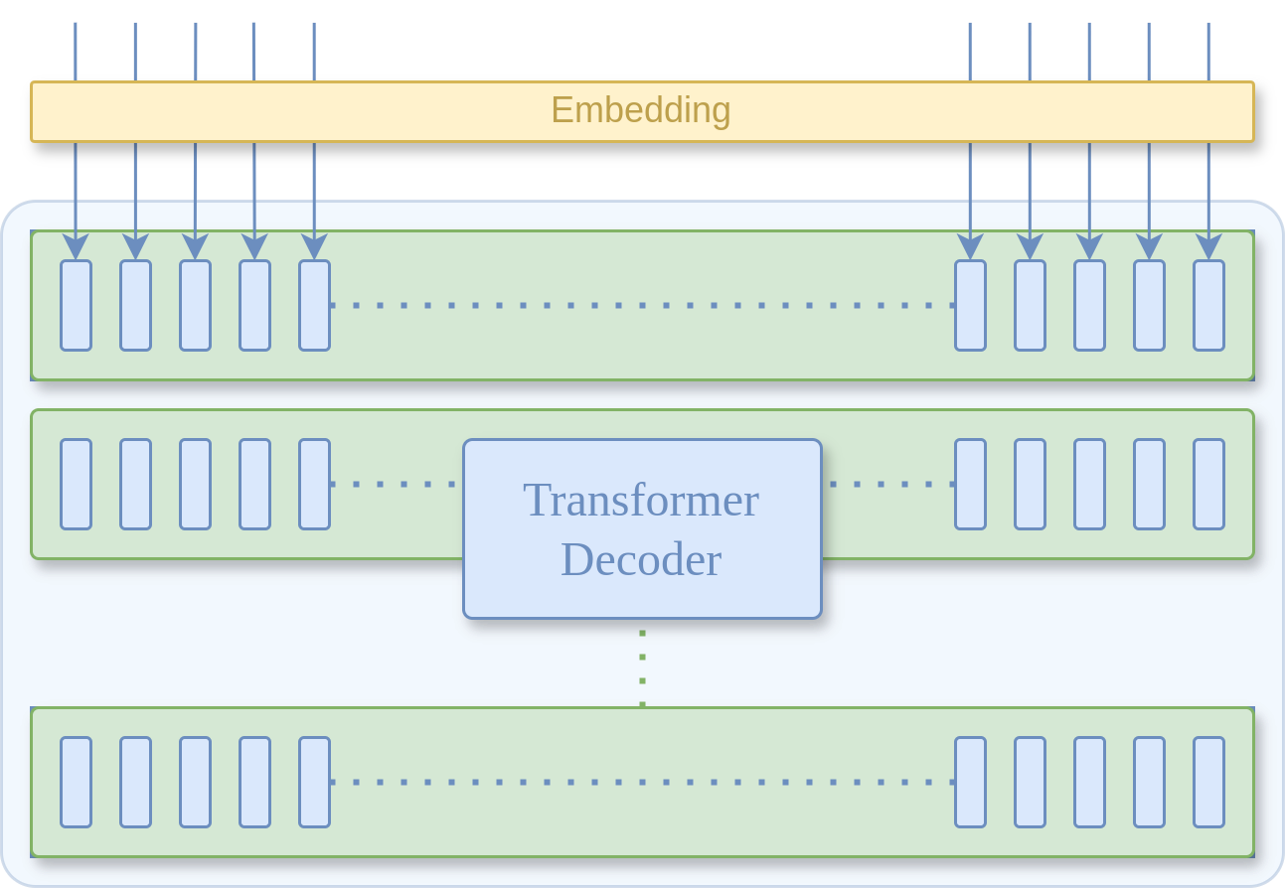
Supervised Fine-tuning
Input (Task + Text)
Target (Result)
Salamander
justifications
2023
.
and
Summarize
their
this
report
:
Human annotators are required to make supervised datasets.
Input | Source
Task | Written by human annotator
Text | Business report, book, documentation, etc.
Result | Written by a human annotator

Slide 7
Lifecycle of LLMs
Examples of fine-tuning tasks:
Adding instructions into prompts (instruction tuning)
Training new task-specific parameters (adapters)

Slide 8
Inference
capybara
sample from the produced distribution to select the next input token
The
dog
cat
capybara
pizza
extra
a
Softmax function

Slide 9
Self-Attention
Consider the sequence “The dog runs.”
The
dog
runs
.
The
dog
runs
.
0
1
2
4
0
1
2
4
dog
runs
.
<EOS>
dog
runs
.
<EOS>
“Causal” self-attention
“Bidirectional” self-attention

Slide 10
Self-Attention
Consider the sequence “The dog runs.”
Objective: Maximize P (w_{n+1} | w₀ …w_{n})
Sequence_{[0:n]} | P(w_{n+1})
The | P(“dog” | “The”)
The dog | P(“runs” | “The dog”)
The dog runs | P(“.” | “The dog runs”)
The dog runs . | P(“<EOS>” | “The dog runs .”)
The
dog
runs
.
0
1
2
4
dog
runs
.
<EOS>
“Causal” self-attention

Slide 11
Self-Attention
For each step, the model “attends” to all previous tokens in the sequence. This is known as “self-attention”.
“Causal” self-attention only attends to previous tokens in a sequence.
“Bidirectional” self-attention can attend to any token within the sequence.
The
dog
runs
.
0
1
2
4
dog
runs
.
<EOS>
“Causal” self-attention

Slide 12
Self-Attention – The First Layer
Example of self-attention with a max context length of n
“Self-attention heads” refer to a submodule of transformer that computes attention scores.
Scores are computed using the dot product of the Q*, K*, and V* vectors.
The
dog
runs
.
Convert discrete words to continuous vectors.
Embedding
n x 768
Create a query, key, and value vector from each embedding.
0
1
…
n
The produced vectors
Q
K
V
768 x 64
Q*
K*
n x 64
V*
n x 64
64 x n
The dot product of Q* and K* provides us with a weight for each token as it relates to each other token.
×
n x n
Q*
K*
n x n
n x 64
n x 64
softmax( ) ×
Z*
QK*
V*

Slide 13
Self-Attention – The First Layer
This operation is key for understanding attention.
We produce a matrix of weights comparing each token with each other token.
n x 64
64 x n
×
n x n
Q*
K*
Before softmax
After softmax
 | The | dog | runs | .
The | 75 | 0 | 0 | 0
dog | 45 | 65 | 0 | 0
runs | 20 | 75 | 40 | 0
. | 15 | 60 | 30 | 40
 | The | dog | runs | .
The | 1 | 0 | 0 | 0
dog | 0.4 | 0.6 | 0 | 0
runs | 0.1 | 0.7 | 0.2 | 0
. | 0.05 | 0.6 | 0.15 | 0.2

Slide 14
Self-Attention – The First Layer
Each “head” contains different parameters, learns different features, and produces a different Z*.
Z* is further processed by a feed forward stack before being passed to subsequent layers.
Our vectors Z* produced by the attention head.
Z*
n x 64
MLP
“Feed forward” refers to a stack of Multilayer Perceptrons with a non-linearity between them.
Non-Linear Function
MLP
The output vector X* is then fed to the next layer.
X*

Slide 15
Self-Attention
Each layer has its own Self-Attention and Feed Forward stacks within it.
More layers leads to a higher parameter count for the model.
Layer 1
Slide 12
Self-Attention
Slide 14
Feed Forward
Layer n
Self-Attention
Feed Forward

Slide 16
The Difference Between Causal and Bidirectional
“Masking” refers to the process of forbidding a model from attending to certain elements in the context.
The
dog
runs
.
Embedding
0
1
2
4
To predict the token after “dog”, we don’t need access to “runs” or “.”
We can apply a mask vector to set their attention scores to a very small value.
1
1
0
0

Slide 17
Fine-Tuning
Benefits
Better accuracy than few-shot prompting
No need for examples = more context space available at inference
Caveats
Very computationally expensive
A lot of GPU memory required
Difficult to pool memory in consumer GPUs
A100s cost CAD 20K

Slide 18
Fine-Tuning
Fine-tuning is expensive because of mixed-precision training.
16-bit is used for more efficient computations.
32-bit is used for training stability.
Module | Bytes
Parameters (32-bit) | 4
Gradients (32-bit) | 4
Optimizer State (32-bit) | 4
Parameters (16-bit) | 2
Gradients (16-bit) | 2
Optimizer State (32-bit) | 4
Total | 20
32-bit
7 billion parameters × 20 bytes
=
140GB GPU Memory
16-bit

Slide 19
Fine-Tuning with Adapters
Adapters introduce new parameters to a model which are trained during fine-tuning.
Typically, the model’s pre-trained parameters will no longer be trained during adapter fine-tuning.
70M Parameter Adapter (1%)
7B
Parameter
LLM
7B
Parameter
LLM
Pre-training all 7B parameters
Fine-tuning only the 70M adapter parameters

Slide 20
Fine-Tuning with Adapters
Using adapters, we can update the estimate for our memory pool.
70 million parameters × 20 bytes
=
1.4GB GPU Memory
7 billion parameters × 4 bytes
=
28GB GPU Memory

Slide 21
Fine-Tuning with Adapters
QLoRA stands for Quantized Low Rank Adapters.
The 32-bit parameters can be represented with 4-bit floats when frozen while preserving utility.
70M Parameter Adapter (1%)
7B
Parameter
LLM
(4-bit quantized)
[link]

Slide 22
Fine-Tuning with Adapters
With QLoRA, we can further update our estimate.
70 million parameters × 20 bytes
=
1.4GB GPU Memory
7 billion parameters × 0.5bytes
=
3.5GB GPU Memory
About 3.5% of our original estimate!!!

Slide 23
Fine-Tuning with Adapters
In summary
Adapters are great for low-resource fine-tuning
Small amount of trainable parameters may overfit more easily
Adapters offer no speed or memory boosts at inference time

Slide 24
Fine-Tuning with Adapters – Demo Scripts
Fine-tuning GPT-3.5-turbo for multi-document question answering
Fine-tuning Mistral-7B-Instruct for sentence classification using QLoRA

Slide 25
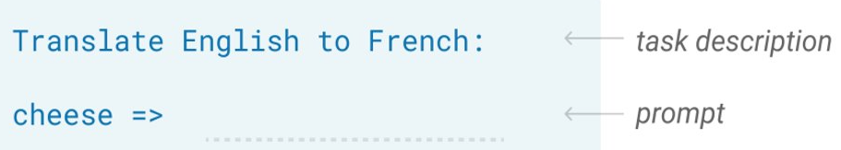
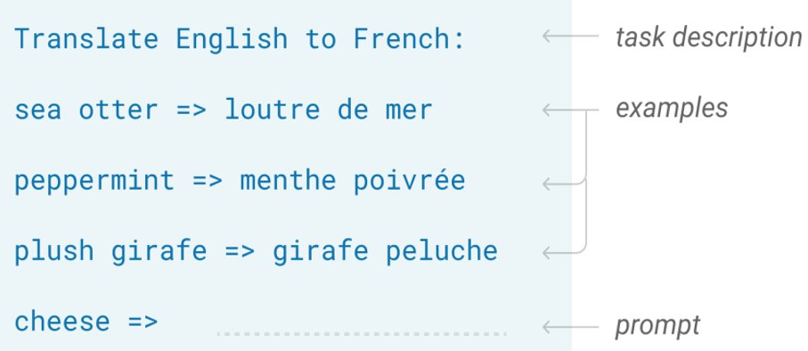
Prompt Engineering
Zero Shot
The model predicts the answer given only a natural language description of the task.
Few Shot
In addition to a task description, the model sees a few examples of the task.

Slide 26
Prompt Engineering
Benefits of Few Shot Prompting
Easily define an output format
Better results than zero shot
Caveats
Requires several annotated examples
Requires more context space
[Best Practices for Prompt Engineering]

Slide 27
Prompt Engineering – Chain of Thought
Motivating a language model to explain itself through intermediate steps is called “Chain of Thought” prompting.
Input
Q: Roger has 5 tennis balls. He buys 2 more cans of tennis balls. Each can has 3 tennis balls. How many tennis balls does he have now?
A: Roger started with 5 balls. 2 cans of 3 tennis balls each is 6 tennis balls. 5 + 6 = 11. The answer is 11.
Q: The cafeteria had 23 apples. If they used 20 to make lunch and bought 6 more, how many apples do they have?
[Link to Paper]
One shot example of an explanation
Model Output
A: The cafeteria had 23 apples originally. They used 20 to make lunch. So they had 23 - 20 = 3. They bought 6 more apples, so they have 3 + 6 = 9. The answer is 9.
Common mistake: Asking for the answer before the explanation. Why?

Slide 28
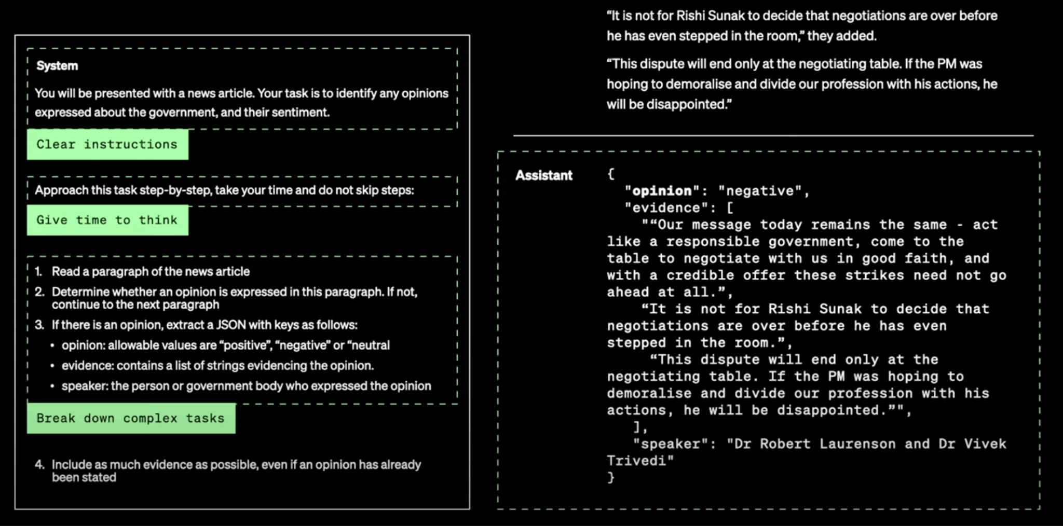
Prompt Engineering – What a good prompt looks like
OpenAI Video on Maximizing LLM Performance

Slide 29
Prompt Engineering – Make parsing easier
Add the tags <PERSON></PERSON> around words that are people’s names. Add the tags <ORG></ORG> around words that are names of organizations, companies, institutions, etc. Add the tags <LOCAL></LOCAL> between words that are the names of places, cities, states, countries, etc.
Example 1:
Input: John eats pizza.
Output: <PERSON>John</PERSON> eats pizza.
Example 2:
Input: Bob Smith works at Microsoft in Seattle.
Output: <PERSON>Bob Smith</PERSON> works at <ORG>Microsoft</ORG> in <LOCAL>Seattle</LOCAL>.
Example 3:
Input: Brasilia is the capital of Brazil.
Output: <LOCAL>Brasilia</LOCAL> is the capital of <LOCAL>Brazil</LOCAL>

Slide 30
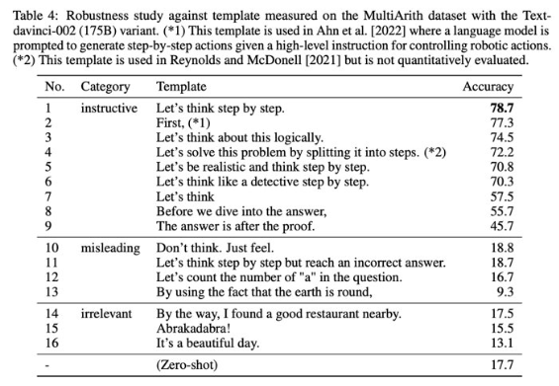
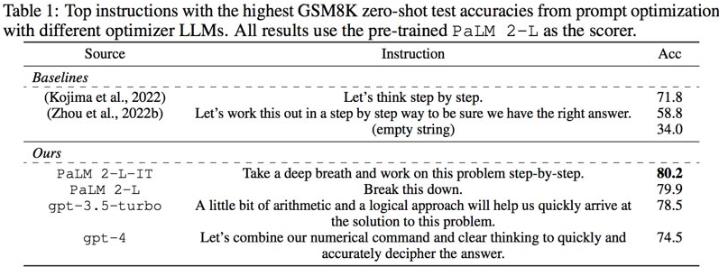
Prompt Engineering – Limitations
Large Language Models are Zero-Shot Reasoners
Large Language Models as Optimizers

Slide 31
Lab 2 – Few-shot Multi-document Question Answering with Mistral-7B
In this lab, you’ll be assembling groups of “documents” and using Mistral-7B to answer queries about them.

Slide 32
End of Module 2
Questions?

